Slide 1

Text Complexity and Readability Analysis

Slide 2
Data collection and processing

Slide 3
Data collection and processing

Slide 4
Data collection and processing
Root
A
2
C
D
E
F
7
B
5
6
21
5
20
G
H
2
I
1
J
1
K
1
2017
Root
A
2
C
D
E
F
7
B
5
6
21
5
20
G
H
2
I
1
J
1
K
1
2018

Slide 5
Headlines Analysis - Unmatched Results

Slide 6
Headlines Analysis - Matched Results

Slide 7
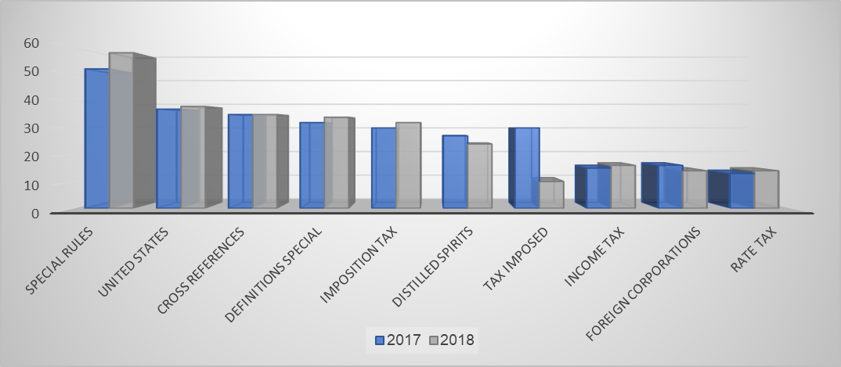
Headlines Analysis - N-Grams
Top 10 Headlines
2018 | 2017 | Bigram
58 | 52 | special rules
38 | 37 | United States
35 | 35 | Cross references
34 | 32 | Definitions special
32 | 30 | Imposition tax
24 | 27 | distilled spirits
10 | 30 | tax imposed
16 | 15 | income tax
14 | 16 | foreign corporations
14 | 13 | Rate tax
10 | 16 | payment tax
14 | 12 | gain loss
11 | 14 | Trust Fund
14 | 11 | gross income
12 | 12 | provisions relating
13 | 11 | life insurance
12 | 12 | General Provisions
12 | 11 | taxable year
11 | 11 | taxable income
11 | 11 | Failure file
11 | 10 | Excise tax
10 | 10 | certain foreign

Slide 8
Model and Algorithm extension
Comparative analysis to examine similarity (semantic and lyrical) between units of information, in a sample of cases where the headlines were found similar
Hierarchy Level | Parent Title | Total Children 2017 | Total Children 2018 | Matching Children Same Level | Avg Semantic Matches | Agv Levenshtein Matches | Avg Jaccard Matches
1.Subtitle | 11 | 71 | 71 | 53 | 8.27 | 7.82 | 4.91
2.Chapter | 70 | 165 | 163 | 212 | 3.64 | 3.76 | 3.06
3.Subchapter | 153 | 178 | 164 | 0 | 1.67 | 1.88 | 0.00
4.Part | 131 | 98 | 1736 | 15 | 0.59 | 0.16 | 0.11
Total | 365 | 512 | 2134 | 280 | 1.86 | 1.80 | 0.78

Slide 9
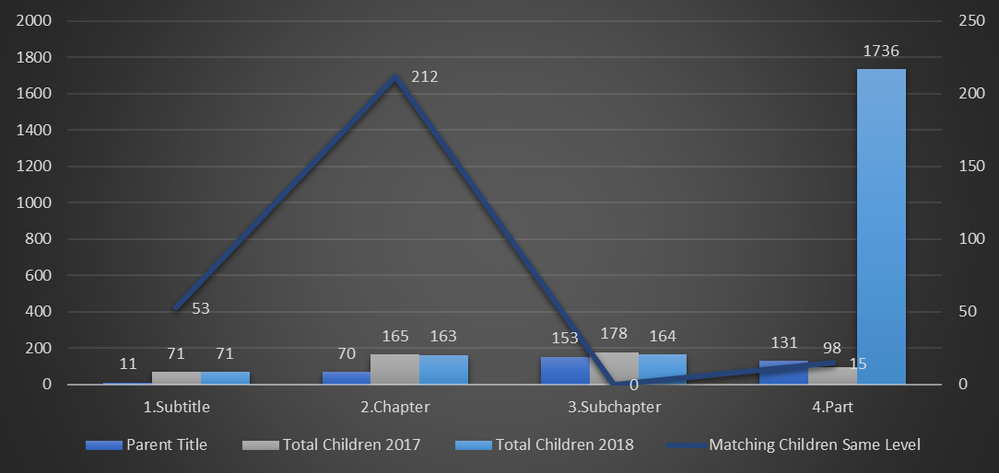
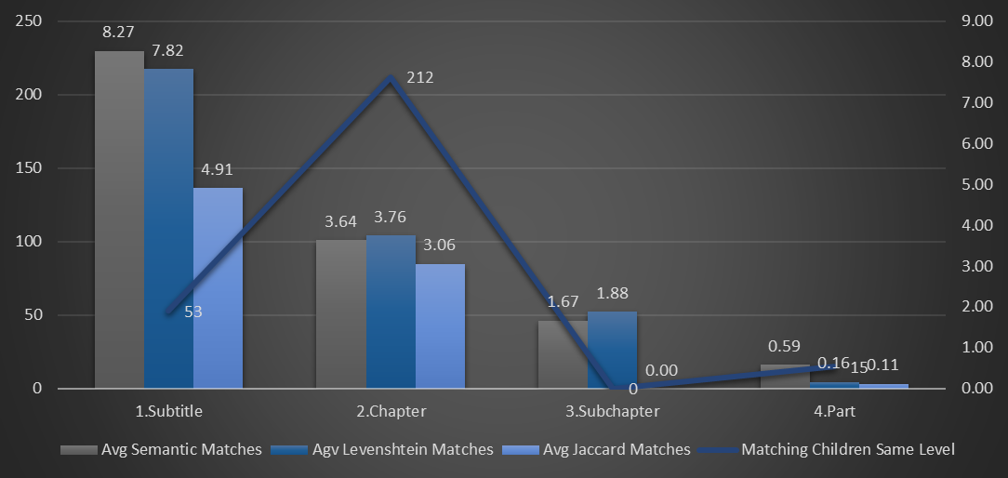
Model and Algorithm extension
Comparative analysis to examine similarity (semantic and lyrical) between units of information, in a sample of cases where the headlines were found similar

Slide 10
Tasks assignment
# Cat. | # | Category | Task | Assign to | Due date | Status
1 | 1.1 | Data Collection & Preprocessing | Download publicly available versions of the U.S. Tax Code for the years 2017 and 2018 in PDFs | Tomer | 08/12/2024 | DONE
 | 1.2 |  | Develop scripts for data and features extraction from the Tax Codes (2017 + 2018) | Yifat | 22/12/2024 | DONE
 | 1.3 |  | Clean and structure the data into CSV format | Yifat | 01/01/2025 | DONE
 | 1.4 |  | Review and quality control of the extracted data | Tomer | 02/01/2025 | IN PROGRESS
2 | 2.1 | Project Definition | Writing a full characterization & definition of the project, according to final project design template | Tomer+ Yifat | 01/01/2025 | DONE
3 | 3.1 | Model Building & Integration | Headings and titles analysis - develop scripts to identifying semantic similarity using LaBSE and lexical similarity using Jaccard Score and Levenshtein distance. | Tomer+ Yifat | 22/12/2024 | DONE
 | 3.2 |  | Model and Algorithm extension - comparative analysis to examine similarity (semantic and lyrical) between smaller units of information, in a sample of cases where the titles were found to be similar. | Tomer+ Yifat | 05/01/2025 | DONE

Slide 11
Tasks assignment
# Cat. | # | Category | Task | Assign to | Due date | Status
3 | 3.3 | Model Building & Integration | Examining common words and phrases, between the code before/after the reform (using N-Grams) | Revital | 05/01/2025 | DONE
 | 3.4 |  | Examining statistical indices of common words/phrases (such as: median, average, etc.), and Visual presentation (Histogram and other relevant graphs) | Revital+ Ori | 05/01/2025 | IN PROGRESS
 | 3.5 |  | Model and Algorithm extension - Expanding semantic similarity and lexical similarity, considering headings and content | Tomer+ Yifat | 19/01/2025 | TO DO
 | 3.6 | Model Building & Integration | Model and Algorithm extension - analyzing structural analysis | Tomer+ Yifat | 19/01/2025 | TO DO
 | 3.7 |  | Compute number of words, number of headings and subsections and number of paragraphs with similar titles | Revital | 29/01/2025 | TO DO
 | 3.8 |  | Develop scripts for hierarchical parsing and cross-referencing | Tomer+ Yifat | 29/01/2025 | TO DO

Slide 12
Tasks assignment
# Cat. | # | Category | Task | Assign to | Due date | Status
4 | 4.1 | Dashboards & Reporting Development | Build initial interactive dashboards for visualization (presented to end users\legal and technical stakeholder) | Ori+ Guy | 29/01/2025 | TO DO
 | 4.2 |  | Implement customizable reporting features | Ori+ Guy | 29/01/2025 | TO DO
 | 4.3 |  | Fine-tuning of the dashboards and customizable reporting features according to legal and technical stakeholder's requirements | Tomer+ Yifat | 06/02/2025 | TO DO
5 | 5.1 | Project documentation | Writing a detailed report (10 pages) explaining the project process, decisions made and evaluation | Tomer+Yifat+ Revital | 21/01/2025 | TO DO
 | 5.2 |  | Review, quality control and proofreading of the project report | Tomer+Yifat+ Revital | 26/01/2025 | TO DO
 | 5.3 |  | Writing relevant sections in the article intended for publication, addressing the analysis of tax code complexity using NLP models | Tomer+Yifat+ Revital | 27/02/2025 | TO DO
 | 5.4 |  | Review, quality control and proofreading of the article | Tomer+Yifat+ Revital | 01/03/2025 | TO DO
6 | 6.1 | Evaluation and Testing | Validate results and gather feedback from legal and technical stakeholders | Team | Untill 15/03/2025 | TO DO

Slide 13
Tasks assignment - Timeline
Data Collection & Preprocessing
Project Definition
Model Building & Integration
Dashboards & Reporting Development
Project documentation
Evaluation and Testing
December
January
February
March

